Slide 1
Additions to the IBTA 1.5 Specification
Overview of significant updates to the IBTA Specification 1.5

Slide 2
Specification update overview
Volume 1, Release 1.5, published August 6, 2021
The specification defines InfiniBand and RoCE
Available to IBTA Members
2038 pages
22 issues addressed
57 new sections/features added
InfiniBand NDR speeds
QoS and bandwidth enhancements
Virtualization section updated
Memory Placement Extensions

Slide 3

Management Working Group Updates
IBTA - Management Working Group

Slide 4
Support Enhanced Speeds
The spec includes support for InfiniBand NDR speeds
Including split support (2x)
RoCE follows the Ethernet Physical & Link Layer Standards
  RoCE fully supports 400 Gb/s and future speeds
Link Speed | Lane Speed | Signaling | 2X throughput | 4X throughput | 8X throughput
EDR | 25.78125 Gb/s | NRZ | 51.5625 Gb/s | 103.125 Gb/s | 206.25 Gb/s
HDR | 53.125 Gb/s | PAM4 | 106.25 Gb/s | 212.5 Gb/s | 425 Gb/s
NDR | 106.25 Gb/s | PAM4 | 212.5 Gb/s | 425 Gb/s | 850 Gb/s

Slide 5
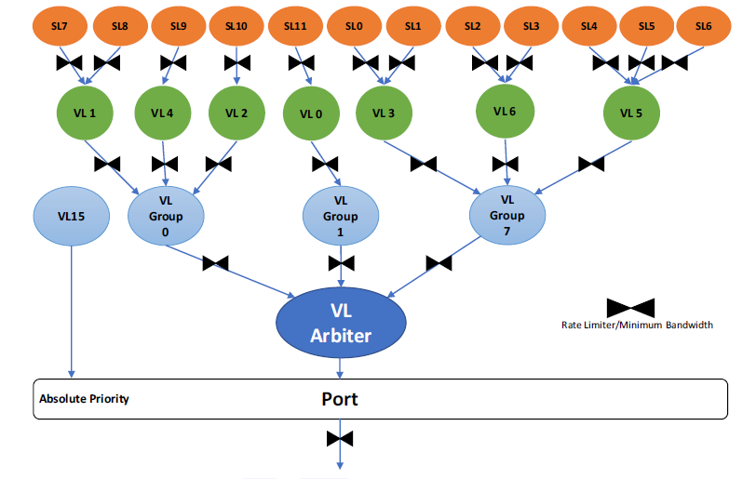
Minimum Bandwidth Added to Enhanced Port Arbiter
Added new minimum bandwidth setting capabilities to VLs and VL groups
The new capability allows setting a bandwidth consumption threshold that allows the entity to get a higher priority when it falls below this value
Available only for enhanced
port arbiter

Slide 6
Minimum Bandwidth Use Case
Can be used for traffic that requires low latency and low jitter.
Examples
  Non VL15 management traffic
  Time sync
  Heartbeat protocol
Port Arbiter
Data
Data
Data
Data
Data
Heartbeat
Data
Heartbeat

Slide 7
Virtualization Chapter Enhancement
Refinement of explanations
Added definition of initialization requirements
Added multiple cross references to other management chapters
Reindexed virtualization attributes to match the order in the subnet management chapters
Simplified and clarified the logic in virtualization chapter and other management chapters

Slide 8
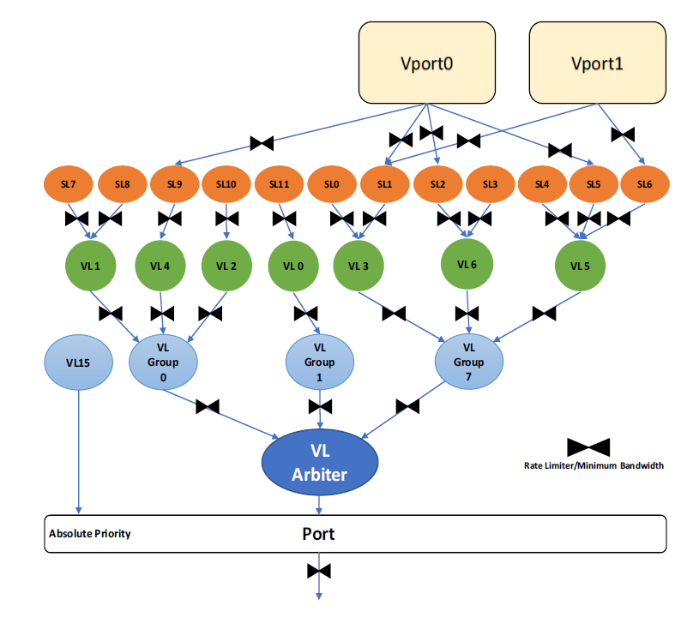
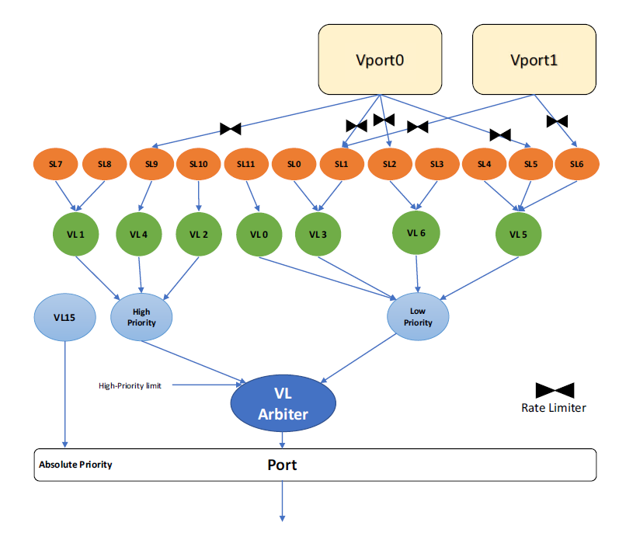
Virtual Ports QoS
Introduce bandwidth sharing and rate limiting configuration for {Vport,SL} on top of either port arbiter
Enhanced Port Arbiter
Standard Port Arbiter

Slide 9
Virtual Ports QoS Use Case
Exposure of per tenant QoS configuration, allows admin to limit bandwidth consumption per tenant.
Multiple VMs sharing a physical network interface configured with a limit of bandwidth consumption
Server
VM1
Hypervisor
HCA
VM2
VM1
VM2
VM1
VM2

Slide 10
LWG Memory Placement Extensions (MPE)
IBTA – Link Working Group

Slide 11
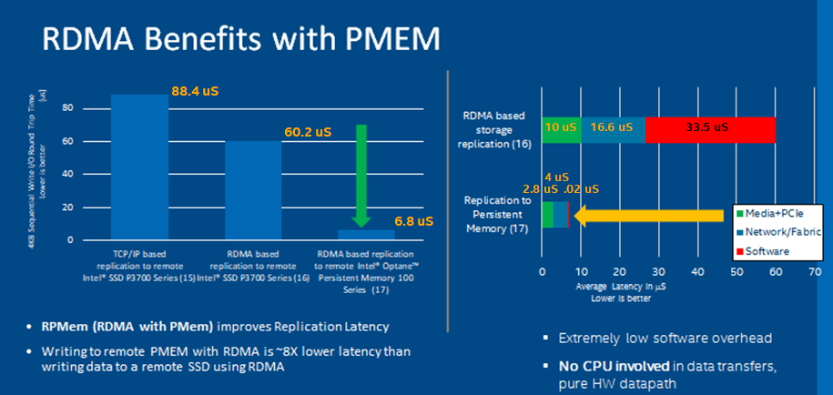
Memory Placement Extensions
Motivation/problem statement
  The performance demonstration below compares round trip latency for RDMA to an SSD vs RDMA to PMEM
  Because the PMEM is byte addressable and is attached to the memory subsystem, it is possible to transfer data to the final persistence domain with minimal CPU involvement utilizing RDMA.

Slide 12
Memory Placement Extensions
Motivation/problem statement
  With the advent of PMEM, storage is now connected to the memory subsystem and can be directly accessed using RDMA
  However, existing RDMA did not provide RDMA Write or Atomics reliability guarantees
  RDMA Write completion does not guarantee data has reached remote host memory
  Any guarantees that the data has reached the persistence domain must be implemented by an ULP. This requires interrupts, pipeline stalls, adding additional latency to the transaction, and may not be scalable.

Slide 13
Memory Placement Extensions
Motivation/problem statement details
RDMA Acknowledge (and Completion)
  Guarantee that Data has been successfully received and accepted for execution by the remote HCA
  Doesn’t guarantee data has reached remote host memory
Further guarantees are out of the scope of the standard
There are platform specific ways to implement further guarantees
  E.g. messaging + SW cache flushing
  E.g. RDMA READ

Slide 14
Memory Placement Extensions
Two new command opcodes in the 1.5 specification
  Flush
    Flush all previous writes or specific regions, per QP
    Provides acknowledgement that volatile writes have made it to Global Observability
    Provides acknowledgement that persistent memory writes have made it to the power fail safe persistence domain
    Pipelined operation
  Atomic Write
    Writes an aligned 8-byte value atomically
    Provides guarantees for remote pointer updates to persistent or volatile memory
Fully supported by InfiniBand and RoCE

Slide 15
Memory Placement Extensions
Synchronous Log Writing with MPE
  Synchronous log writing: Requestor Host application wishes to send an 8 byte pointer update to PMEM only if the log data (write 1) was written to PMEM first
  Requestor Host application issues a FLUSH operation after RDMA Write 1 to force the Responder HCA to flush the writes before completing the FLUSH response
  Without waiting for the FLUSH completion, the Requestor Host application can queue an ATOMIC WRITE operation to update the 8 byte pointer
  Ordering rules prevent the Responder HCA from executing the ATOMIC WRITE until the previous FLUSH has completed
  This allows the Requestor Host application to queue the RDMA WRITE, FLUSH, ATOMIC WRITE, in a pipelined manner, without waiting for this to be done by an ULP, and without stalling the pipeline
Requestor
Host
Requestor
HCA
Responder
HCA
Responder
Host
Responder
Memory
Register Memory Range
RDMA WRITE1
FLUSH
RDMA WRITE1
ATOMIC WRITE
FLUSH
ATOMIC WRITE
Flush memory subsystem
Completion
Completion
Read Response
Completion
Transport Flow for synchronous log writing to PMEM – With MPE

Slide 16
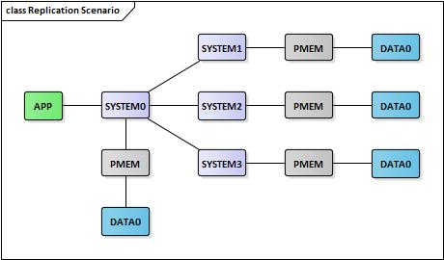
Memory Placement Extensions
Scenarios where MPE can improve performance
  Synchronous Replication
    Multiple physical copies of all data are replicated on several systems before the original data is considered Highly Available (HA)
    According to several CSPs:
    High priority network latency sensitive scenario for datacenters adopting PMEM
    Advantageous to perform consistency checks on replica data in-line, pipelined with the remotes writes & flushes

Slide 17
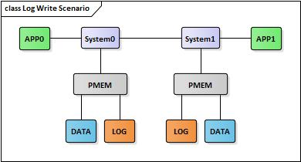
Memory Placement Extensions
Scenarios where MPE can improve performance
  Synchronous Log Writing
  Shared data is distributed amongst multiple systems
  Log Files keep track of transactions applied to the data
  High priority network latency sensitive workload for SQL adoption of PMEM
  Advantageous to perform consistency checks on log data in-line, pipelined with the remote writes & flushes

Slide 18
MPE Details
FLUSH and ATOMIC WRITE

Slide 19
Memory Placement Extensions
MPE Initialization
Allocate persistent memory buffer on Responder system
Handle
RDMA
Network
Registering memory with Responder HCA:
-Address
-Length
-PMEM – Used for GV/PMEM FLUSH selector
-FLUSHABLE – Indicates FLUSH of the region is allowed
Application
DRAM
HCA
HCA
PMem
Application
TPT:
Handle:
PMEM, FLUSHABLE
Buffer
Requestor System
Responder System
Handle for memory registration made available to Requestor application
APP
HW
Application Memory Allocation
RNIC Memory Registration
RNIC Memory Registration Response Handle
Memory Handle shared with Requestor app

Slide 20
Memory Placement Extensions
FLUSH to Global Visibility (GV)
RDMA
Network
Application
DRAM
HCA
HCA
GV POINT
DRAM
Writing data to Responder
volatile memory
TPT:
Handle:
GV, FLUSHABLE
APP
HW
RDMA WRITE
Flushing previously written data to Responder volatile memory
RDMA WRITE RSP
Application
GV
HCA
DRAM
FLUSH
DRAM
GV
HCA
GV POINT
FLUSH RSP
TPT:
Handle:
GV, FLUSHABLE
Requestor System
Responder System

Slide 21
Memory Placement Extensions
FLUSH to Persistence (PMEM)
RDMA
Network
Application
DRAM
HCA
HCA
PMEM POINT
PMEM
Writing data to Responder
persistent memory
TPT:
Handle:
PMEM,
FLUSHABLE
APP
HW
RDMA WRITE
Flushing previously written data to Responder persistent memory
RDMA WRITE RSP
Application
PMEM
HCA
PMEM
FLUSH
DRAM
PMEM
HCA
PMEM POINT
FLUSH RSP
TPT:
Handle:
PMEM,
FLUSHABLE
Requestor System
Responder System

Slide 22
Memory Placement Extensions
Pipelined Log Writing Example
RDMA
Network
Application
HCA
PMEM POINT
PMEM
APP
DRAM
HCA
Writing data to Responder
persistent memory
HW
Flushing previously written data to Responder persistent memory
RDMA WRITE
PMEM
PMEM
RDMA WRITE RSP
FLUSH
Updating Log pointer in Responder
persistent memory
FLUSH RSP
ATOMIC WRITE
ATOMIC WRITE RSP
Requestor System
Responder System

Slide 23
Call to Action and for more information
Join the IBTA and download the spec
  https://www.infinibandta.org/ibta-specification/
RDMA vendors:
  Implement MPE in your IB and RoCE adapter(s)
RDMA users:
  Enhance your application(s) and ULP(s) to leverage MPE

